Slide 1
St. Swithin’s Hospital Case
By Jack & Andrew

Slide 2
Problem Statement
DVT (Deep Vein Thrombosis) is vein disease that will potentially cause PE (Pulmonary Embolus), a worse disease that could be fatal.
Patients go to hospital for diagnosis when they find they have DVT symptoms
There are three types of diagnosis: 1. Doppler test, 2. Venography, 3. IPG test, which venography is more accurate but have strong side effect while others are safe and less accurate
The case is viewed from three perspectives: hospital, patients, and physicians, each has a different goal.
Determine for each situation, what tests to use and whether or not to do the treatment.

Slide 3
Perspectives & Goals
# | Subject | Goal
1 | Hospital | Min induced dvt & cva
2 | Patient | Min death/disability rate
3 | Patient | Max life rate
4 | Physician | Max correctness of diagnosis

Slide 4
Assumption
Assumed patients would accept long-term disability if their goal is to maximise life rate
Assumed patients will do the treatment if they are sure they have DVT (eg. venography)
Assumed cost is not the problem for making decisions
Assumed minor disability and lung problem are considered as healthy
Assumed the correctness of IPG test is 100%
Assumed if people only do the IPG test, they won’t do treatment if result is negative and vise versa.
Assumed the IPG diagnosis correct rate is accurate

Slide 5
Model Development
Define variables:
P - Positive test results, N - Negative test results
D - Has DVT, ND - Doesn’t have DVT
PE - Has PE, NP - No PE, I - Has induced DVT, NI - not induce DVT
DI - diagnosed results, NDI - non-diagnosed results
(T) - Treament is forced

Slide 6
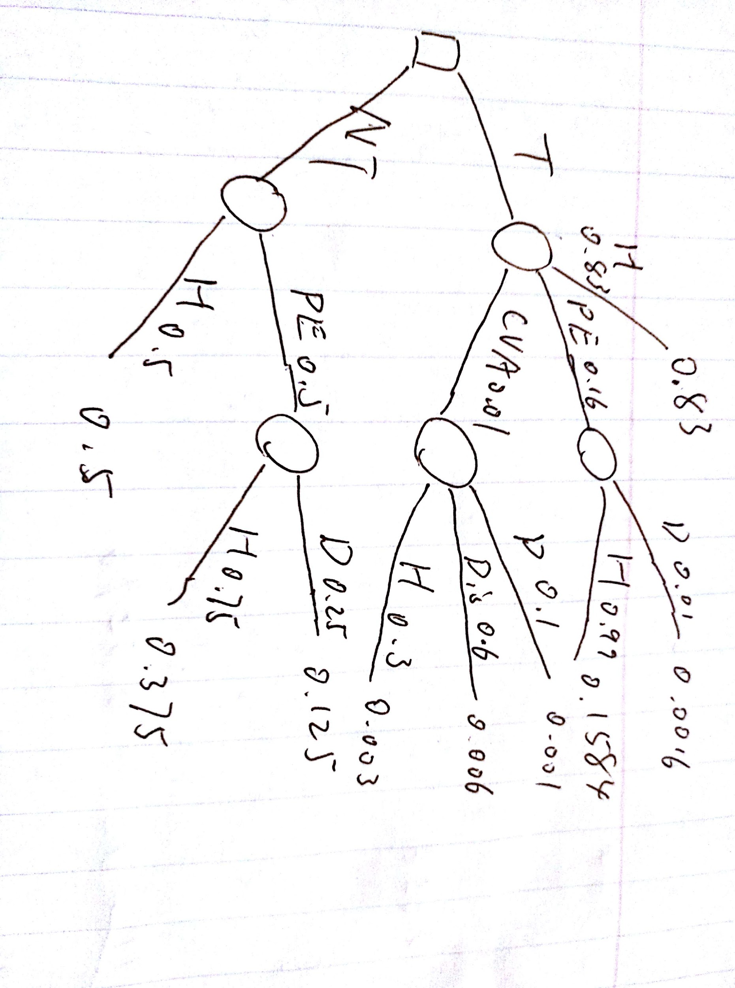
Model Development
Basically there are 4 main situations, that is 1. with a DVT, do the treatment, 2. Wrong diagnose, don’t really have DVT, but do the treament, 3. No DVT, don’t do the treatment, 4. Wrong diagnose, actually has DVT, don’t do the treatment.
If the patient has dvt, the decision tree is as follows:

Slide 7
Model Development
For situation 1 & 2,
P(death) = 0.0016+0.001 = 0.0026, P(disability) = 0.006
P(healthy) = 0.003+0.83+0.1584 = 0.9914
For situation 3:
P(healthy) =1
For situation 4:
P(death) = 0.125, P(healthy) = 0.875

Slide 8
Treatment or Not
Patients want to know whether not not to do the treatment when the test result is positive. The answer is always do the treatment. Let the diagnose correct rate be x where treat and not treat have an equal death/disability rate. x*0.125 = 0.0086
Solve for x = 0.069 meaning that as long as the correctness is greater than 6.9%, doing treatment will reduce the death/ disability rate.

Slide 9
Doppler Test
Given the probabilities for each situation in the case, the total death/1000 is 416*0.0026+ 68* 0.125 = 9.58, the total disability/1000 is 416*0.006 = 2.5, the rest are healthy, therefore, death/ disability rate is 1.21%, life rate is 99.04%
Cva death/disability rate = 0.007*416/1000 = 0. 29%
Diagnose correctness is = 0.798* 0.4 +0.884*0.6 = 0.8496
Sum of Type 1 & 2 errors per 1000: 68+84 = 152

Slide 10
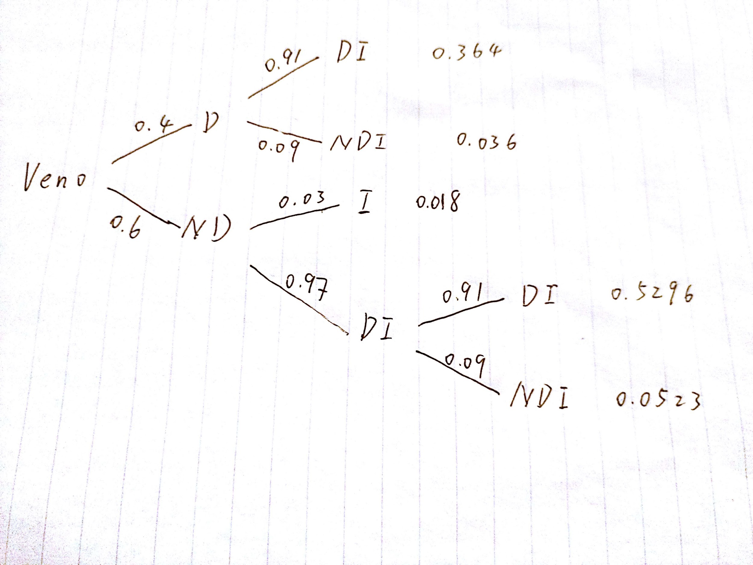
Venography: decision tree
NI

Slide 11
Venography Cont’d
The overall death/1000 is (364+52+36)*0.0026+ (18)*0.125 = 3.43, disability is (364+52+36)*0.006 = 2.71. Death/disability rate = 0.61% life rate = 99.66%
Cva & induced DVT death/disability rate = 0.007*452/1000 + 18/1000* 0.125 = 0.54%
Diagnose correctness is (324+530)/1000 = 85.4%
Sum of Type 1 & 2 errors per 1000: 0

Slide 12
IPG test
Of those who are getting a positive test result, they are do the treatment, for those with a negative result, they will be healthy because no PE will occur.
Total death per 1000 people = 137/426*1000*0.0026 = 0.836 disability = 137/426*1000*0.006 = 1.93
Diagnose correctness is 415/426 = 97.4%
Cva caused death/disability rate = 0.25%
Sum of Type 1 & 2 errors per 1000: 25.8

Slide 13
Test Selection
Obviously IPG test has the best performance over all of the 3 perspectives. So that is a must do test. But will extra doppler test or venography helpful to the diagnose?
There are three options, 1. IPG, then doppler, 2. IPG then venography, 3. IPG then doppler then venography.
Since the wrong diagnosis only happens when patients get a positive test results. They won’t need to do more tests when the result is positive.

Slide 14
Test Selection Cont’d
The probability of not having DVT: having DVT changes to 11: 126 = 0.08: 0.92, as discussed in page 16 sensitivity analysis. The higher the DVT rate, the less reliable doppler test is because number of DVT negative increases. However venography will improve. So the best option is do IPG first, then do a venography.

Slide 15
Sensitivity Analysis
As mentioned the case description document, the actual correctness of doppler test is higher than the given ones. Suppose that the actual rate is 2 % higher, therefore 340 out of 400 DVT patients will be tested positive and 528 non-DVT patients will be tested negative.
New death = 412*0.026+60*0.125 = 8.57, which reduce by 10.5% compared to the original value of 9.58. New disability = 412*0.006 = 2.47
New type 1 &2 error = 132
Correctness = 86.8%
Doppler test would do a lot better than previous, but still IPG is better choice.

Slide 16
Sensitivity Analysis
What is the actual DVT rate of patients who claims to have DVT symptoms is higher than 40 percent. What if it is 45 percent. Results of IPG tests won’t be affected, however venography and doppler test will change. For venography, less people will get induced DVT, but more . New treatment number is (0.09*0.97*0.55+0.45)*1000 = 498 per 1000 people increased by 46 while the actual DVT carrier increases by 50. So the test overall improves. The new death will be 1.3
For Doppler, the new treatment number is 451, new death is 10.7 which increases because the total number of wrong diagnose increases(DVT negative).

Slide 17
Conclusion
Always do the treatment if any test result shows positive
Do IPG test if only test can be selected
Doppler test is not good even its actual correctness rate is higher
As the DVT percentage becomes higher, venography becomes better and doppler becomes worse.
The best option is do IPG first, then do a venography.

